Slide 1
Special Education for English Learners: An Overview
Presented by:
Joanna Della Gatta, Director, Ventura County SELPA
Nadia Villapudua, L.E.P., Manager, Oxnard School District Mary E. Samples, Assistant Superintendent, Ventura County SELPA www.vcselpa.org

Slide 2
Why is it important to talk about English Learners?
A Moral & Legal Obligation
Individuals with Disabilities Education Act 2004
Preventing Disproportionality
The number of English Learners in CA decreased from 2014-2015 to 2015-2016.
In 2015-2016, English learners constituted 22% of all students in CA schools.
In 2016-2017, English Learners with Disabilities constituted 26% of all students with disabilities in Ventura County (12/1/16 CASEMIS).
Most “at-risk” learner subgroup
Notes:
Joanna

Slide 3
IDEA 2004 A Response to Dramatic Changes….
“America’s ethnic Profile is rapidly changing”…..20 U.S. C. § 1400 (c) (B)
“Minority children comprise an increasing percentage of public school students” 20 U.S. C. § 1400 (c) (C)
“The limited English proficient population is the fastest growing in our Nation…” 20 U.S. C. § 1400 (c) (11)(A)
“…Discrepancies in the levels or referral and placement of limited English Proficient children in special education….” 20 U.S. C. § 1400 (c) (10) (B)
Notes:
Nadia

Slide 4
Overview
General Education Practices and Pre-referral Interventions
Initial/Annual English Language Development Assessment
Designated and integrated
RtI for ELs
Language acquisition stages
Disability vs. language development
Assessment and Identification for English Learners for Special Education
Language proficiency
Tool selection
Interpreters
ELA/ ELD Framework and California Common Core Standards for ELD
IEP Development
Collaboration with EL specialist
Goals
Service Delivery
Best practices
Reclassification of English Learners with Disabilities
Notes:
Nadia: Gen ed Practices , pre-referral, assessment and identification
Joanna: IEP Development

Slide 5
Initial/Annual Assessment of English Language Development
Home Language Survey
California English Language Development Test (CELDT). 2016-17 and 2017-18 CELDT Information Guide.
CDE website/Testing & Accountability/ Testing/ California English Language Development Test
http://www.cde.ca.gov/ta/tg/ep/documents/celdt1618guide.pdf
Alternate to the CELDT – Ventura County Comprehensive Alternate Language Proficiency Survey (VCCALPS).
SELPA website/Resources for Teachers and Staff/English Learners/Resources
http://www.vcselpa.org/Portals/0/Resources%20for%20Teachers%20&%20Staff/English%20Learners/VCCALPS.pdf?ver=2016-03-14-144433-440
Preschool English Language Survey (PELS) for Preschoolers who are being assessed for SPED and Current Preschoolers in SPED.
SELPA website/Resources for Teachers and Staff/English Learners/Resources
http://www.vcselpa.org/Portals/0/Resources%20for%20Teachers%20&%20Staff/Early%20Start/Preschool/PELS.pdf?ver=2015-10-21-093210-700
Notes:
Joanna: PELS is not mandated, but used for students in the process of being identified for SPED or already have an IEP

Slide 6
Initial/Annual Assessment of English Language Development
English Language Proficiency Assessments for California (ELPAC)
http://www.elpac.org/
Field testing for the new ELPAC will begin in Spring 2017.
The ELPAC will become operational in 2018.
The ELPAC will consist of the Summative Assessment administered in Spring 2018 and the Initial Assessment administered beginning July 1, 2018.
The annual Summative Assessment window will be a four-month window after January 1 (proposed February 1 to May 31).
Notes:
Joanna

Slide 7
Initial/Annual Assessment of English Language Development
Initial identification of students as English learners
Annual summative assessment to measure a student’s progress in learning English and to identify the student's ELP level
The IEP determines if the student will take the alternate and if so, provides the justification for assessing using the alternate in the IEP.
Notes:
Joanna

Slide 8
Pre-Referral: General Education Practices and Interventions
Notes:
Nadia

Slide 9
Central Question
Is this student’s academic difficulty possibly due to a
learning disorder or
limited English proficiency?
Notes:
Nadia

Slide 10
Pre-referral Considerations for ELs
EC 56303. A pupil shall be referred for special educational instruction and services only after the resources of the regular education program have been considered and, where appropriate, utilized.
5 CCR 3030 ….(i) Data that demonstrate that prior to, or as a part of, the referral process, the pupil was provided appropriate instruction in regular education settings, delivered by qualified personnel;
Notes:
Nadia

Slide 11
High Quality Instruction for ELs
“It is fully expected that all English learners will receive high quality CCSS-based instruction as well as ELD standards-based instruction”
California ELD Standards, 2012 (Appendix D (p.4)) as cited in ELITE 2016-VCOE Curriculum and Instruction
Notes:
Nadia

Slide 12
DUAL OBLIGATION
OBLIGATION #1 Designated ELD
Protected time during the regular school day where qualified teachers work with English learners grouped by similar proficiency levels
Main Focus
Student production of language (Speaking and Writing) using the CA ELD Standards
ELITE 2016-VCOE Curriculum and Instruction
Notes:
Nadia: Designated ELD is NOT RTI or an intervention. Designated ELD is required.

Slide 13
DUAL OBLIGATION
OBLIGATION #2 Integrated ELD
Providing meaningful access to ALL grade-level CCSS academic content through research based strategies and techniques (SDAIE) used in tandem with ELD Standards
Main Focus
Accessing & mastering content standards across all disciplines while using ELD standards to amplifying/highlight the key language knowledge and skills needed for ELs to succeed
ELITE 2016-VCOE Curriculum and Instruction
Notes:
Nadia

Slide 14
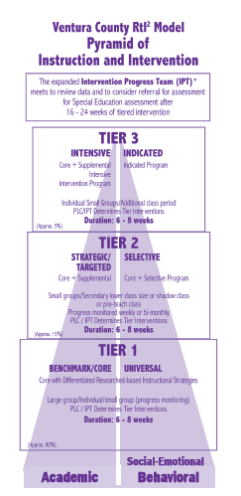
Ventura County RtI2/MTSS
VCOE/Programs and Services/Curriculum and Instruction/RtI2 MTSS
Notes:
Joanna: The Ventura County Research-Based Model (preschool through Grade 12) was developed in 2007 in response to the needs of our educational community with the belief that ALL children and youth can learn. The model is a three-tiered approach to instruction and intervention that includes core, strategic/targeted, and intensive instruction to support the academic as well as the social, emotional and behavioral needs of students….
These models/processes are for all student including Els.

Slide 15
RtI Research
ELLs without learning difficulties or (mild learning disabilities) have been shown to demonstrate gains in phonemic awareness and phonics skills when provided systematic Tier 2 instruction in foundational literacy skills (Vaughn et al., 2006)
ELLs also need sufficient time to develop comparable levels of language proficiency beyond phonology and may need support for years
Students who are ELLs require ongoing and sustained instruction in English language, ELD, as part of the core areas for as long as possible (Dixon, Zhao, & Shin, 2012)
Notes:
Joanna

Slide 16
Guidelines when selecting Interventions for English Learners:
The student’s language proficiency in their native (L1) and second language (L2) across all domains
The linguistic demands of the literacy intervention
Availability of native language support
For Designated ELD students should be grouped with students with similar proficiency levels.
For targeted interventions, English learners “may benefit from being grouped with peers with similar learning needs.”
Coffee & Ray-Subramanian, 2010, p.34 as cited in Olvera & Villapudua, 2014, Butterfield, Read 2016
Notes:
Nadia

Slide 17
Critical Pre-Referral Information for ELs
SSTs: A systematic process that provides data on
4 Key Elements:
Background Information (e.g. years in U.S, instructional program, language of instruction, gaps in instruction)
Student Characteristics (e.g. LI/L2 proficiency, immigration pattern, economic circumstances, cultural interactions)
Classroom Instruction (e.g. Appropriate, Qualified Personnel, Differentiation, Designated ELD & Integrated ELD)
Response to Intervention (e.g. Tier 1, Tier 2)
Brown & Doolittle, 2008 as cited in Butterfield, 2014
Notes:
Nadia: Native language Proficiency assessed by language appraisal team, looks different in each district and based on the stage of the referral process
Refer to most updated VCOE RTI Student Review Form A http://www.vcoe.org/Portals/7/Curriculum-Instruction/Documents/RtI/Form%20A%201.17.2017.pdf
Handout

Slide 18
Are typical patterns in the language acquisition process being displayed?
Preproduction (3 months) – silent period
Early production (3-6 m)-using 1-3 words
Speech emergence (6m-2y)- simple sentences
Intermediate fluency (2-3y)- better comprehension, BICS
Advances fluency 5-7 years up to 20 years
Interference, Inter-language, Silent Period, Code Switching, Language Loss, Language Difference
Ochoa, et al., 2005
Notes:
Nadia:
As the EL is acquiring BICS and CALP which can be a long process 10-12 years
At each language acquisition stage the student will display particular characteristics. The key question, that the SST is trying to tease out is the child’s learning struggles are due to the normal processes of 2nd lang. acquisition and the typical errors we would expect.
Interference: communicative behavior from one language are transferred over: “toma una silla” “take a seat” instead of “have a set”
Code switching: using two different language in the same sentence.
Adjective come after nouns- The house green, Past tense ed is often ommited: We walk yesterday
Superiority is demonstrated by using “mas”. This car is more big.
I had the pleasure of working with a principal that had been Director of ELL services I would be in awe knowledgeable she was of these factors. She would often ask teachers to bring samples that showed language development progression in comparison to the other student in class with similar CELDT levels. This was extremely helpful in determining how his/her language progression compared to other students with similar language cultures.
(Handout )Reference Butterfield’s Handout- Comparison of Language Differences Versus Disability. – we are going to do this reference a bit later

Slide 19
Dr. Butterfield’s Matrix
Are the language indicators the student displays possibly due to a:
Language Difference due to 2nd language acquisition
OR
Possible Disability?
http://www.sbcselpa.org/wp-content/uploads/2014/03/ELL-Vs-Learning-Disability-Chart-copy.pdf
Notes:
Joanna and Nadia:
Provide copies of the handout
Read 1-2 examples

Slide 20
BilingualAssessment.org: Pre-referral Resources
Notes:
Nadia:
Walk through the pre-referral resources on the website and how they could be used.
Language History Interview form handout

Slide 21
Collaboration of EL specialists/experts in SST
Is there at least 1 SST/IPT member who is knowledgeable of English Language development factors and programs in your team?
Notes:
Nadia

Slide 22
Talk to Your Partner….
Does your school or district routinely include an EL representative at your SST/IPT meetings?
How would having an EL representative at SST meetings be helpful?
Notes:
Nadia

Slide 23
Referral, Assessment & Identification for Special Education
Notes:
This pertains to all Initials and Triennial for ELs who are being assessed for SPED.

Slide 24
LANGUAGE PROFICIENCY assessment is the “FOUNDATION” of Psychoeducational Assessment of English Learners

Slide 25
Tool Selection
EC 56320. (a) materials and procedures shall be provided in the pupil’s native language or mode of communication, unless it is clearly not feasible to do so.
EC 56320. (b)Tests and other assessment materials … Are provided and administered in the language and form most likely to yield accurate information
EC 56320. (a) (d) Tests are selected and administered … produces test results that accurately reflect the pupil’s aptitude, achievement level, or any other factors the test purports to measure and not the pupil’s impaired …speaking skills.
Notes:
Nadia

Slide 26
Assessment Modalities
Consider the advantages and disadvantages of the main modalities:
1. Modified Altered Testing
2. Non-verbal Testing or Language Reduced Testing
3. Native Language Testing only
4. English Language Testing
Alfonso, et.al., 2014
Notes:
Nadia

Slide 27
Review Other Language Proficiency Data
PRE-LAS
LAS
CELDT
SABE
ADEPT
IPT
VCCALPS
Ventura County SELPA Preschool English Language Survey PELS
Notes:
Nadia

Slide 28
Examples of Language Proficiency Tools
WJ-IV Oral Language
Woodcock-Munoz Language Survey (updated 2017)
Bateria III Woodcock- Munoz
Bilingual Verbal Ability Test
Notes:
Nadia

Slide 29
Tool Selection & Language Proficiency Resource
Guidelines For Assessment For Special Education Of English Language Learners (2012) by VC SELPA (pg. 27-54)
www.vcselpa.org/ Resources for Teachers and Staff/English Learners/ Resources
Notes:
Nadia

Slide 30
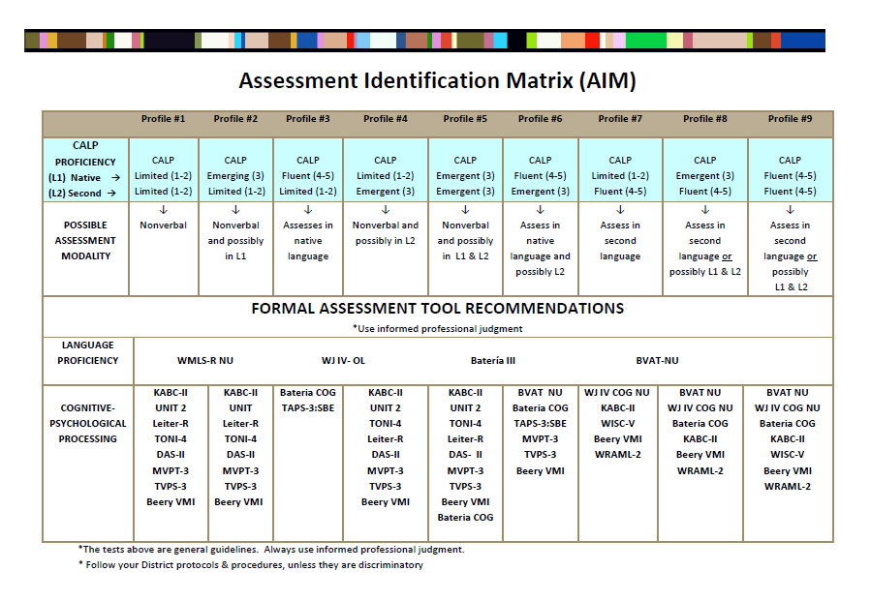
Tool Selection & Language Proficiency Resource
Assessment Identification Matrix (AIM)
Tool that assists practitioners in determining assessment modality based on CALP level in LI and L2
Provides suggestions for formal tools
www.bilingualassessment.org
Notes:
Nadia:
Materials: AIM Handout
Assessment Identification Matrix (AIM) is a broad adaptation of the integrative model derived primarily from Ortiz and Ochoa, 2005 MAMBI
Bilingual assessment tools were initially developed in collaboration with the Bilingual Assessment Committee at Conejo and later collaboration with Dr. Pedro Olvera. The inspiration for this was a beautiful series that our SELPA put on in 2011, regarding non-discriminatory assessment of EL’s.
Describe reason for online access, google, number of viewers has exploded. Prestigious institutions, viewers time on site has increased. Type bilingual assessment- free!
Review Handout Purpose, Define Terms, Demonstrate Language Spectrum. Emphasize that is a guideline only. Professional judgement, adherence to legal requirements, and best practices and your district policies are always a must.

Slide 31
Qualified Personnel
EC 56324.(a) ….shall be conducted by a credentialed school psychologist who is trained and prepared to assess cultural and ethnic factors appropriate to the pupil being assessed.
CCR 3023. (a) ….competent in both the oral or sign language skills and written skills of the individual’s primary language or mode of communication and have a knowledge and understanding of the cultural and ethnic background of the pupil. If it clearly is not feasible to do so, an interpreter must be used, and the assessment report shall document this condition and note that the validity may have been affected.
Notes:
Nadia

Slide 32
Guidelines for Utilizing Interpreters
What are the indications/recommendations in the test manual?
At minimum, interpreter should be equally fluent in English and the native language of the student and parents
Trained in Neutrality and Confidentiality
Trained in assessment procedures and standardization
Possession of cultural knowledge
Ochoa, S.H., Ortiz, S.O., & Rhodes, R.L. (2005)
Notes:
When utilizing and interpreter, the law does not specify exactly who/title of the person who should assess. However, these are additional recommendations to keep in mind.
Pg. 88 of Guidelines
Pg 101 of Assessing
In the resources you will find a quick training checklist that you can use to ensure your interpreters are trained.
Rendering the message faithfully
Cultural knowledge is necessary in order to interpret words or phrases, idioms that may not be interpretable without the cultural frame of reference

Slide 33
Additional Legal Requirements
EC 56001. (j) & EC 56320. (a) Procedures and materials for use with pupils of limited-English proficiency…, shall be in the individual’s native language
EC 56001. (j) & EC56320. (e) “…No single assessment instrument shall be the sole criterion for determining the placement of a pupil…”.
CCR 3023 (b) The normal process of second-language acquisition, as well as manifestations of dialect and sociolinguistic variance shall not be diagnosed as a handicapping condition.

Slide 34
Talk to Your Partner….
During the special education assessment process, how might you collaborate with an EL representative?
What questions might you have for an EL expert during the assessment process?

Slide 35
ELD Standards
Language acquisition is treated as a non-linear linguistic and social process
Asset vs. deficit approach (literacy foundational skills target varying profiles of ELs, tapping linguistic resources
Focus on teaching academic English
Notes:
Joanna

Slide 36
ELD Standards Correlations to CELDT
CELDT Modes of Communication => CCSS Domains of Language Acquisition
CELDT New ELD
Listening Collaborative
Speaking Collaborative
Reading Interpretive
Listening Interpretive
Speaking Productive
Writing Productive
CELDT Language Proficiency Levels => Common Core Standards for ELD
CELDT New ELD
Beginning Emerging
Early Intermediate (low) Emerging
Early Intermediate (high) Expanding
Intermediate Expanding
Early Advanced (low) Expanding
Early Advanced (high) Bridging
Advanced Bridging
Notes:
Joanna

Slide 37
Individualized Education Program (IEP) Development
Notes:
Joanna

Slide 38
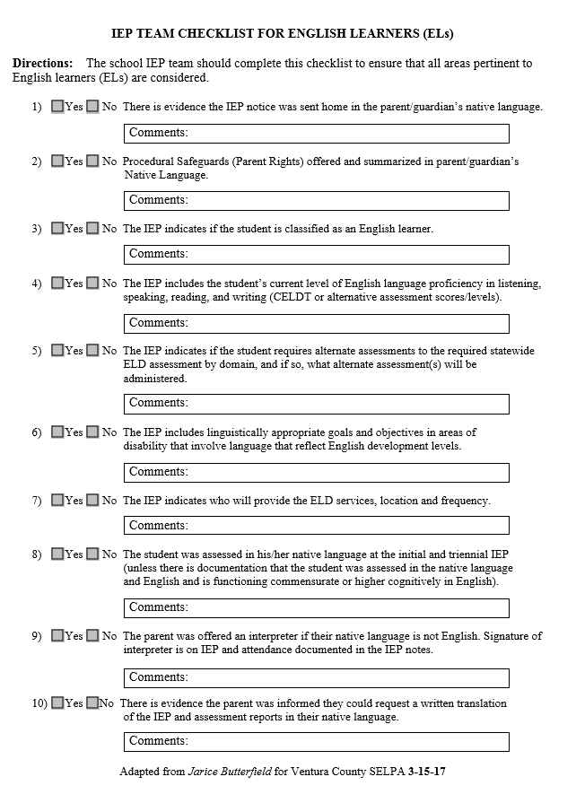
Resource for the IEP Team
IEP TEAM CHECKLIST FOR ENGLISH LEARNERS (ELs)
Adapted from Jarice Butterfield for Ventura County SELPA
Notes:
Joanna

Slide 39
Preparing for the IEP
Who should be invited?
Interpreter
A person with expertise in second language acquisition
Most recent language proficiency level from the CELDT / VCAALPS and date administered- ok to use unofficial scores
If Preschool to Kindergarten, language proficiency level from the PELS
Has the student been reclassified since the last IEP? If so, what is the date of the RFEP?
EL status (EL, RFEP, IFEP)
Notes:
Entering everything into the Student Demographics tab makes sure that it is automatically populated in the appropriate places in the IEP. Show the Student Demographics and Assessment Info/DRDP tab in SIRAS and how it works.
The definitive source for EL status is the Student Information System (SIS)

Slide 40
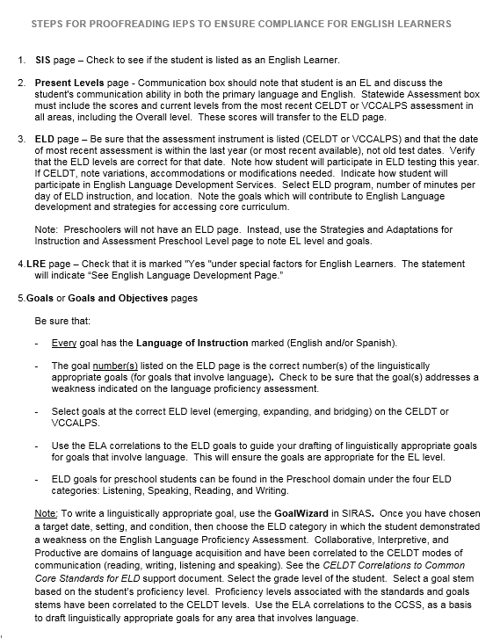
Resources for the IEP Team
STEPS FOR PROOFREADING IEPS TO ENSURE COMPLIANCE FOR ENGLISH LEARNERS

Slide 41
IEP Development for English Learners
5 main areas of the IEP that are affected when a student is an English Learner:
1) Student Information and Services
2) Present Levels: Reading Writing, Communication, Statewide Assessment Results
3) Preschool Strategies (preschoolers) /ELD page (K- age 22)
4) Goals: Language of Instruction for Linguistically Appropriate goals
5) LRE: Special Factors/Language, FAPE (Program and setting)
IEP Notice, Classroom Accommodations, Agreement and Attendance

Slide 42
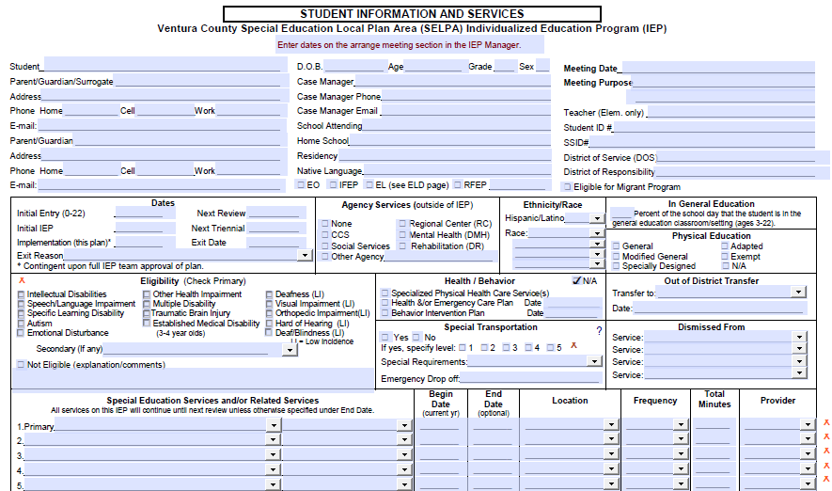
Student Information and Services

Slide 43
Present Levels of Performance
Scores/levels for CELDT/VCCALPS
Summary of progress in language proficiency in Reading and Writing areas and Listening and speaking in the Communication area
Note: For preschoolers, English Proficiency level determined from the Preschool English Learner Survey (PELS) is noted on the Preschool Strategies page.
Notes:
Joanna: a narrative on language proficiency levels in the communication sections. The CELDT scores are not enough. Other Language proficiency assessment

Slide 44
Present Levels of Performance
Academics Reading/Writing:
Made progress (moved from early intermediate to intermediate on the CELDT), increasing in English Language Proficiency.
Communication:
Uses both English and Spanish in the classroom and playground
Struggles with understanding academic English
Uses Mixteco with peers
Communicates with parents in Hmong but uses English conversationally at school
Proficient in basic interpersonal communication skills (conversational) skills
Beginning to develop cognitive academic language proficiency

Slide 45
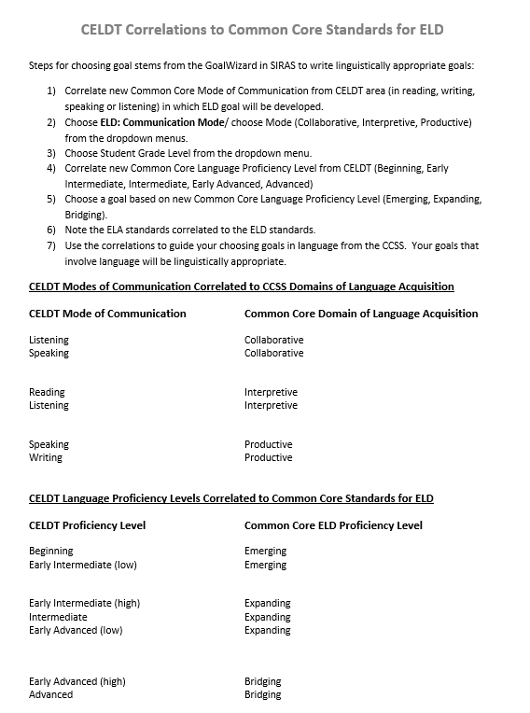
Resource for the IEP Team
CELDT Correlations to Common Core Standards for ELD

Slide 46
Three things to consider when addressing language needs
Language proficiency
Level of functioning
Student’s disability
J.Butterfield, 2016

Slide 47
Goals
Goal(s) drafted address need(s) in the area of English Language Proficiency (Reading, Writing, Listening, Speaking)
Correlate to assessment results (CELDT/ VCCALPS/PELS) and present levels
Goal(s) in the area of language most likely will be in literacy or communication.
Select from the ELD standards in the GoalWizard. Use the correlations to guide your choosing goals in language from the CCSS. Use the ELA correlation to guide the choice of goals that involve language and will be linguistically appropriate!
Notes:
ELD standards are correlated to ELA standards. A student may often score below intermediate in more than one area on the CELDT, (or other), however, select the area(s) that are impacting performance the most, and not the result of the disability. (i.e., listening for DHH).

Slide 48
Linguistically Appropriate Goals
Aligned to students’ current language proficiency level
Aligned to California ELD standards in listening, speaking reading or writing
Drafted to account for students language ability
J.Butterfield, 2016

Slide 49
Preschool Goals
English Language Development: Listening
English Language Development: Speaking
English Language Development: Reading
English Language Development: Writing
Notes:
These 4 categories and aligned with the 4 tests in the PELS (Preschool English Language Survey).

Slide 50
CELDT Areas/Domains of Language in CA Common Core
Listening and Speaking => Collaborative
Speaking and Writing => Productive
Reading and Listening => Interpretive
Notes:
Insert new categories, refer to HO for writing goals using CELDT scores and new CCSS terminology that will align with ELPAC scores once we get them.

Slide 51
Selecting Goals for English Learners
Domain- ELD
Category- Collaborative, Interpretive, Productive
Grade level
ELD Proficiency- Emerging, Expanding, Bridging
ELA Correlations
Notes:
Model how to select goals using the Wizard. Review a sample student from scores to goals choice.

Slide 52
Goals for English Language Development
Area of Need- Reading, Writing, Communication
For goals that involve language
Responsible discipline- tied to location of service on ELD page
Reason for goal- tied to need from CELDT/VCAALPS/PELS scores and present levels
Language of instruction
All language goals must be linguistically appropriate
Notes:
Show example of Goals page in SIRAS.

Slide 53
Talk to your Partner
How might an EL expert assist with developing linguistically appropriate goals?

Slide 54
Preschool Strategies
Locate the following areas on the preschool strategies page of the IEP:
Date student took PELS
EL level
Goal number
Assessment to be given in kindergarten

Slide 55
English Language Development
Recent proficiency levels on the CELDT/VCCALPS EL
Primary language (same as Native Language)
Indicate if student Reclassified before or during the meeting and leave bottom of the form blank.
Note which test student will take for each domain- CELDT or VCCALPS
Indicate adaptations for CELDT if needed- none allowed for VCCALPS
Notes:
Show the ELD page in SIRAS, and that the ELD testing results are already in.

Slide 56
ELD Page (continued)
Program Model: SEI, ELM, Alternative
Instruction: Frequency, Location, and Duration
Goal numbers addressing Language Proficiency
EL strategies and supports are the primary ELD strategies that the student needs (informed by the students disability) to access the core curriculum

Slide 57
Collaboration
SPED and ELD staff Collaborate about strategies to access the core curriculum

Slide 58
Program Models
Structured English Immersion (SEI):
Targeted instruction for students who have not yet mastered BICS (students with overall CELDT or VCCALPS levels of beginning or early intermediate)
English Language Mainstream (ELM)
Instruction with emphasis on CALPS or learning academic language (students with overall CELDT or VCCALPS levels of intermediate or above)
Alternative Educational Program
Student must be enrolled in alternative ELD program to check this option – indicate type
Notes:
Alternate programs include: Transitional Bilingual Education, Developmental Bilingual Education, and Two-Way Immersion.

Slide 59
You must describe:
English Language Development Program and Instruction
-as well as-
Strategies for Accessing Language and Content
Notes:
Review slide You must describe both

Slide 60
ELD Instruction- Locations
Special education class
General education class
General education English class
Special education English class
Pull out program with sp/lang pathologist
Pull out program with special ed teacher
Mainstream English class
Sheltered English class
Notes:
These are suggestions only; any location where ELD services are provided are acceptable and may be typed into the program.

Slide 61
Duration and Frequency
Minimum 30 minutes a day- follow your district guidelines-for secondary, must be at least one full period
Notes:
They should know what their district requires, if not, they should speak to someone in charge of EL.

Slide 62
Strategies for Accessing Core
Anticipatory chart or guide
Graphic organizers or study guides
Primary language support
Use appropriate realia to affirm context
Outlines or reading guides
Pictorial guide or glossary
Teach root words and cognates
Compare / contrast meanings
Charts, graphs, pictures, diagrams
Venn diagrams or story maps
Notes:
SDAIE strategies/UDL

Slide 63
ELD Page
Make sure the CELDT Coordinator receives copies of the ELD page for any students who need adaptations- discuss with your administrator how this is to occur
Notes:
Discuss that each district might want to handle this differently, but we need to make sure the CELDT Coordinator is able to order the right materials, etc.

Slide 64
Least Restrictive Environment

Slide 65
Least Restrictive Environment
Special Factors Affecting Learning and Placement: Language Needs of English Learners

Slide 66
Reclassification of Students with Disabilities
What is your LEA’s Reclassification Criteria?
EL Master Plan
Reclassification worksheet for students with IEPs

Slide 67
Reclassification Worksheet
How does the disability affect language proficiency?
English Language Proficiency
The IEP team reviewed other informal measures of proficiency and determined it is likely the student is proficient in English.
The IEP team has determined that the student’s disability impacts his or her ability to manifest English proficiency.
Possible indicators: Student has similar academic deficits and error patterns in English as well as primary language; error patterns in listening, speaking, reading, and writing are typical of students with that disability versus students with second language issues; VCCALPS scores indicate an overall proficiency level of early advanced or higher.
Is the student’s level of English Language Proficiency commensurate with his/her abilities?
Notes:
For students who do not meet the regular LEA criteria

Slide 68
Reclassification Worksheet
2. Teacher’s Evaluation of Student Academic Performance
Based on Classroom performance, District-wide assessments, Progress toward IEP Goals, Formative Assessment
The IEP team has determined that the deficit is due to the disability, and unrelated to English Language proficiency.
Has the student demonstrated an appropriate level of academic performance commensurate with his/her abilities?

Slide 69
Reclassification Worksheet
3. Comparison of Basic Skills
Student’s Basic Skills assessment scores appear to be commensurate with his/her intellectual ability.
Error patterns noted mirror the patterns of errors made by students with the same disability versus a language difference.
Student has received ELD services for more than three years and academic progress in ELA is commensurate with that of peers who manifest similar disabilities who are not English learners.
Has the student demonstrated an appropriate level of performance in ELA Basic Skills commensurate with his/her abilities?
Notes:
For students who do not meet the regular LEA criteria

Slide 70
Reclassification Worksheet
4. Parent Opinion
Is the primary reason the student does not meet reclassification criteria due to the disability rather than limited English proficiency and the student no longer needs English Language Development services?
Who is involved?
EL Coordinator
School Psychologist
Special Education Teacher
General Education Teacher
Parents

Slide 71
Talk to your Partner…
Can the IEP team reclassify?
Who can the IEP team recommend for reclassification?
When should the discussion begin?
Notes:
Joanna

Slide 72
Service Delivery Models
Dual Language Immersion Programs
In what language should services be delivered (e.g. SAI and Speech Therapy)?

Slide 73
Programs/Services for ELs

Slide 74
Legal Obligation Dear Colleague Letter (US Department of Justice, Office of Civil Rights, January 7, 2015)
https://www2.ed.gov/about/offices/list/ocr/letters/colleague-el-201501.pdf
Notes:
After the supreme court case Lau vs Nichols, the supreme court determined that in order for State ed. agencies to comply with Title VI of Civil Rights Act of 1964 the must take affirmative steps to ensure that LEP student can meaningfully participate in their ed. prog. And services. The OCR and Civil Rights Division provided joint guidance and resources for SEA.

Slide 75
Common Misconception
A common misconceptions is that…..instruction exclusively in English is best for students with processing difficulties.
Research shows that students are able to acquire a 2nd language if they have a firm foundation in their native language, including students with disabilities
Artiles &Ortiz, 2002 as cited in J.Butterfield, 2016
A.Artiles & A.Ortiz (2002) English Language Learners with Special Education Needs

Slide 76
Things to Keep in Mind….
ELs w/Disabilities
Should have access to the same educational & linguistic opportunities as their peers in the LRE
Are capable of meeting high academic standards with the appropriate learning opportunities, supports, services
Have an IEP team that determines on an individual basis the programs and services that will meet the student’s unique needs
J. Butterfield, 2016

Slide 77
Providing Dual Service
ELs with Disabilities must be provided both language assistance & disability related services
The IEP team designing the program should include participants knowledgeable about the student’s language needs
Fact Sheet. Ensuring English Learner Students Can Participate Meaningfully and Equally in Educational Programs Office of Civil Rights Jan.2015

Slide 78
Strategies for English Learners
ELs
SDAIE
Cooperative Learning
Multiple Representations
Providing Context
Activating Prior Knowledge
Sp.Ed.& ELs
Both sets of strategies informed by:
1) Language Proficiency
2) Processing Disorder
3) Goal/Task Demand
4) IEP
Sp.Ed. Students
Adaptations such as: Modifications, Accommodations, Compensatory Strategies, Mnemonic Devices, Assistive Technology
Primary Language Support
Individualized Instruction
Notes:
What curriculum strategies do EL w/disabilities need

Slide 79
Effective Instructional Strategies
Mediated scaffolds
Task scaffolds
Materials scaffolds
Comprehensible input
Cognitive Academic Language Learning Approach
Challenging, theme-based curriculum to develop academic concepts
Strong & on-going collaboration between ELD experts and Special Education Educators
Butterfield, 2016
A.Artiles & A.Ortiz, 2002

Slide 80
Talk to your partner about strategies for ELs with Disabilities…
Use Concrete and Visual representations
Limit the length of linguistic structure
Front load vocabulary
Use controlled vocabulary when giving directions
Avoid passive voice, sarcasm, idioms
Use short noun phrases
Avoid use of subordinate clauses
Promote interaction among learners
Use native language when possible and appropriate
Explicitly teach learning strategies
Notes:
Who should use these strategies?
SDAIE strategies (linguistic support, graphic support, kinesthetic/visual support
Student centered Systematic ELD- time for ELs to learn and practice language in natural contexts

Slide 81
Resources
Ventura County SELPA www.vcselpa.org Resources for Teachers and Staff/English Learners/Resources:
Guidelines for Assessment for Special Education of English Learners
Guidelines for Reclassification of English Learners with Disabilities
Preschool English Language Survey
VCCALPS
Santa Barbara SELPA www.sbcselpa.org Resources/Forms/ English Learners:
EL Resource Book
Comparison of Language Differences vs. Disability Chart
Bilingual Assessment http://bilingualassessment.org/
Assessment Identification Matrix (AIM)
RtI/MTSS Ventura County Model www.vcoe.org Programs and Services/Curriculum and Instruction/RtI/MTSS
Response to Instruction and Intervention Handbook
RtI from WIDA https://www.wida.us/professionaldev/educatorresources/rti2.aspx
Developing a Culturally and Linguistically Responsive Approach to Response to Instruction & Intervention for English Learners
US Department of Education:
English Learner Tool Kit
Dear Colleague Letter

Slide 82
In Conclusion……
Be prepared for:
Assessment
Intervention
Services
IEP Development
Reclassification
And you will do what is right for English Learners!

Slide 83
Please provide your feedback using the feedback form.

