Slide 1
How Will My Child Participate in 2018-2019 State Testing?
Joanna V. Della Gatta, Director
Ventura County SELPA

Slide 2
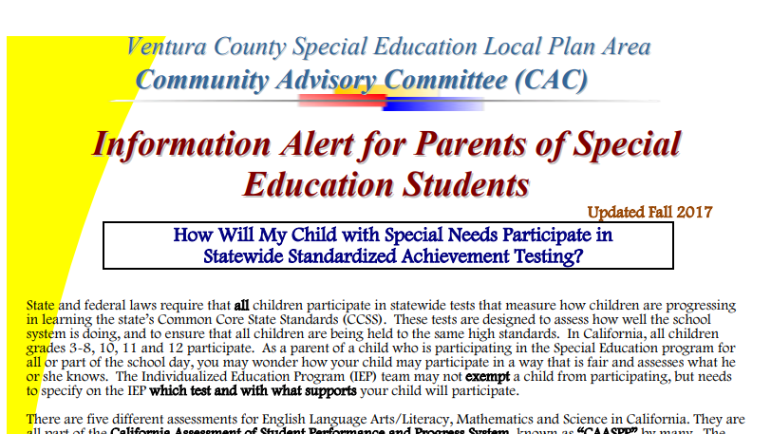
How will my child participate in state testing?
Notes:
Information can be found under the Families tab of the SELPA website.

Slide 3
What test(s) will my student take?
Smarter Balanced Assessment of California (SBAC) or California Alternate Assessment (CAA); Grades 3-8 and 11
English/Language Arts (Grades 3-8 and 11)
Math (Grades 3-8 and 11)
Science (Grades 5, 8 and once in high school)
English Language Proficiency Assessments of California (ELPAC) or Ventura County Comprehensive Alternate Proficiency Survey (VCCALPS)

Slide 4
The Smarter Balanced Summative Assessments
Smarter Balanced Assessments (SBAC) Parent Guide
The Smarter Balanced Summative Assessments are part of the state testing system called the California Assessment of Student Performance and Progress or CAASPP.
The CAASPP System is designed to give information to teachers, students, and their families about what students know and are able to do and whether they are on track to be ready for success in college or career when they graduate from high school.

Slide 5
The California Alternate Assessments for English Language Arts/Literacy (ELA), Mathematics, and Field Test for Science
California Alternate Assessments (CAA) Parent Guide
The California Alternate Assessments (CAAs) are part of the state testing program called the California Assessment of Student Performance and Progress, or CAASPP.
The CAAs are designed for students with the most significant cognitive disabilities. Students are eligible only if an alternate assessment is indicated in their active individualized education program (IEP) by the IEP team.

Slide 6
THE CALIFORNIA ALTERNATE ASSESSMENTS; The Decision To Participate “What is the right test for my child?”
PARENT/GUARDIAN’S GUIDE
This decision is made by the IEP team, and is not just the identification of a specific disability.
The team should talk about the child’s ability to live independently and to function safely in daily life.
An IQ score alone does not determine a significant cognitive disability; rather, an overall understanding of the student is required to make the determination.
A consideration of the student’s adaptive behavior is critical in identifying the need for alternate assessment.
Adaptive behavior is the collection of conceptual, social, and practical skills that are learned and performed by people in their everyday lives.

Slide 7
The English Language Proficiency Assessments for California (ELPAC)
A PARENT GUIDE TO UNDERSTANDING
The ELPAC is the test that is used to measure how well students in kindergarten through grade twelve understand English when it is not their primary language.
The ELPAC is taking the place of the California English Language Development Test (CELDT).
Information from the ELPAC helps your child’s teacher provide support in the right areas.

Slide 8
Grade | English Language Arts (SBAC or CAA) | Math (SBAC or CAA) | Science (CAST or CAA) | English Language Proficiency (ELPAC) for English Learners ONLY
K |  |  |  | X
1 |  |  |  | X
2 |  |  |  | X
3 | X | X |  | X
4 | X | X |  | X
5 | X | X | X | X
6 | X | X |  | X
7 | X | X |  | X
8 | X | X | X | X
9 |  |  |  | X
10 |  |  | District decision | X
11 | X | X | District decision | X
12 |  |  | District decision | X
Notes:
https://www.cde.ca.gov/ta/tg/ca/documents/sbsummativepgtu.pdf

Slide 9
What Supports Will My Child Have For Testing?
Supports for testing should mirror supports in daily instruction and assessment.

Slide 10
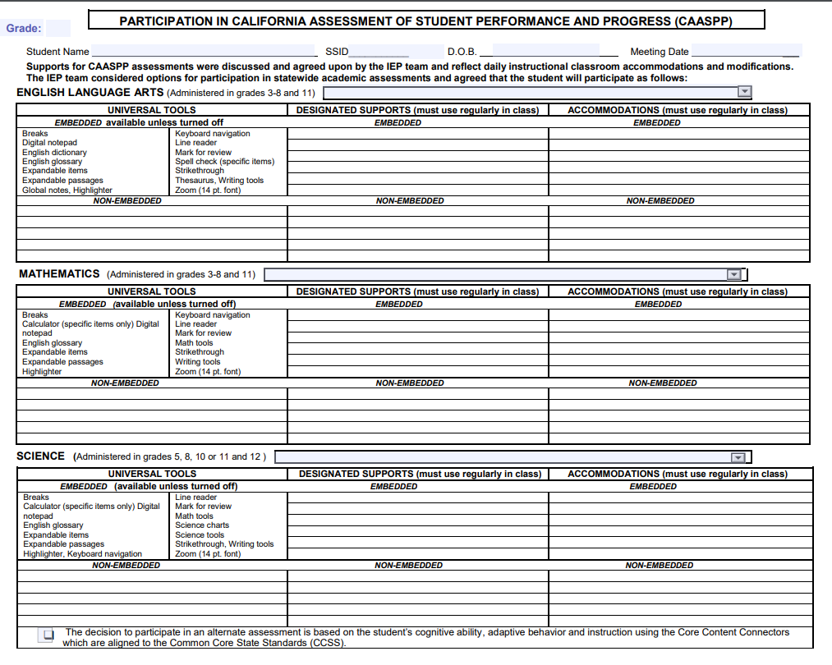

Slide 11
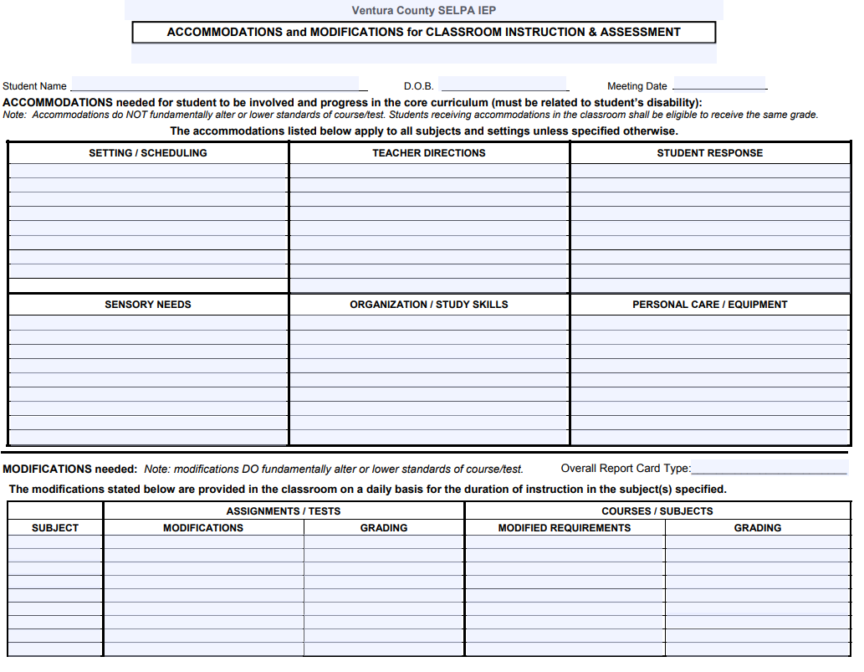

Slide 12
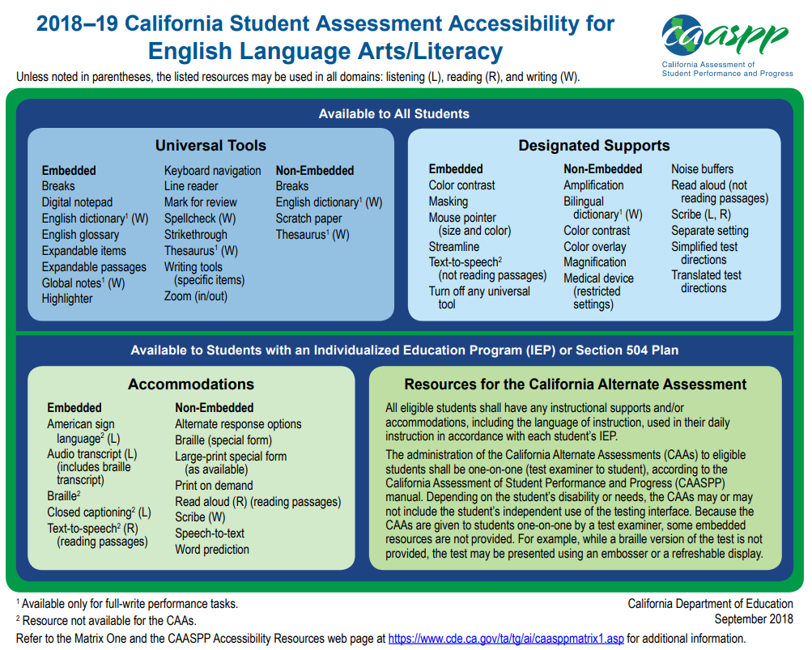

Slide 16
Questions?

